Slide 1
Computer architecture
Виконав:
студент ІІІ курсу
групи ІО-12
Бута Сергій

Slide 2
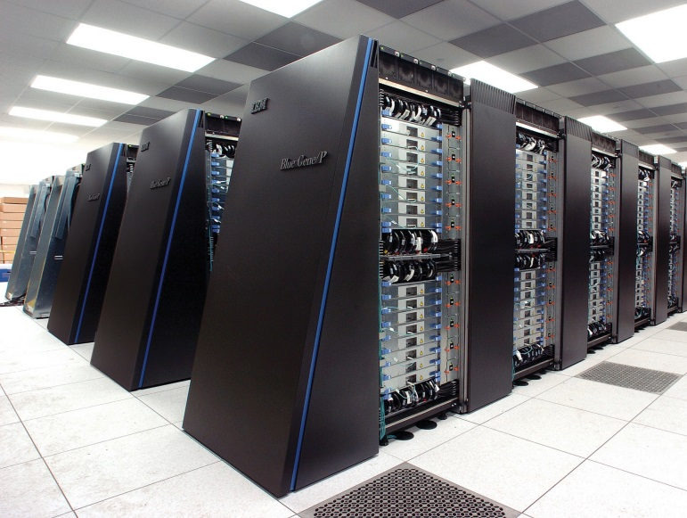
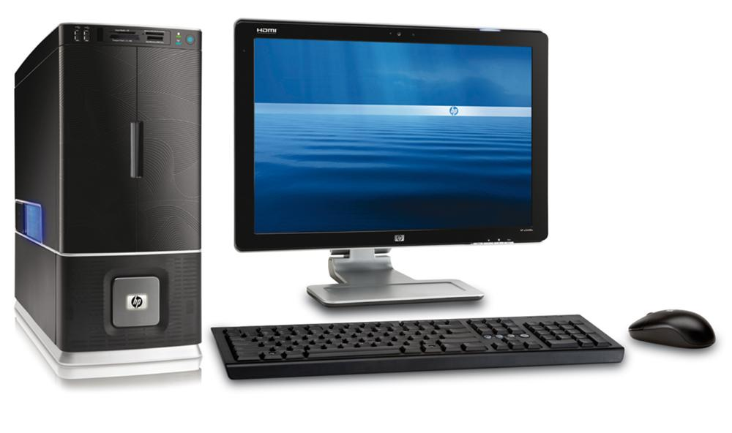
Types of Computer
1. Supercomputer – the most powerful type of mainframe.
2. Mainframe – large,
very powerful, can be used
by many people.
3. Minicomputer – smaller,
than mainframe.
4. Personal computer (PC)

Slide 3
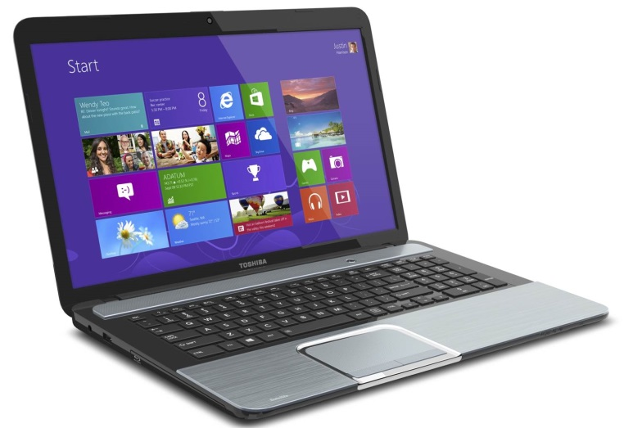
Variety of PC
1. Desktop computer – suitable size for sitting on an office desk.
2. Workstation – most powerful type of desktop, used for graphic design.
3. Portable – can be carried around, can operate with batteries.
4. Laptop - large portable, can
be rested on user’s lap.

Slide 4
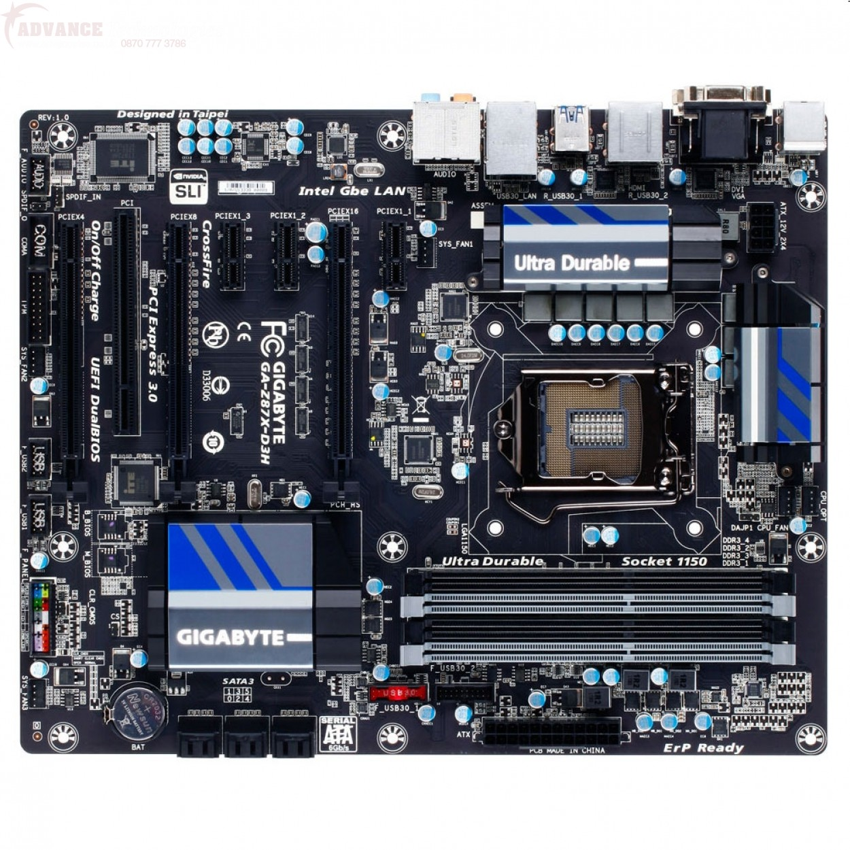
Motherboard
Motherboard is the main printed circuit board found in computers and other expandable systems. It holds many of the crucial electronic components of the system, such as the central processing unit (CPU) and memory, and provides connectors for other peripherals!

Slide 5
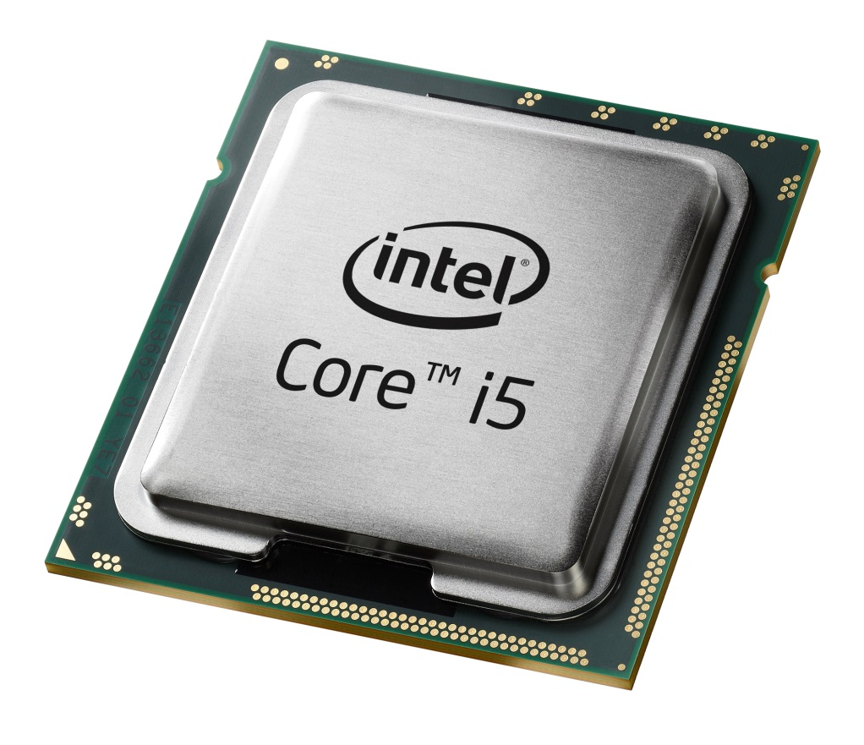
Processor
The processor is the most important part of the computer. Powerful computers used as servers often have more than one processor. Directs all other components

Slide 6
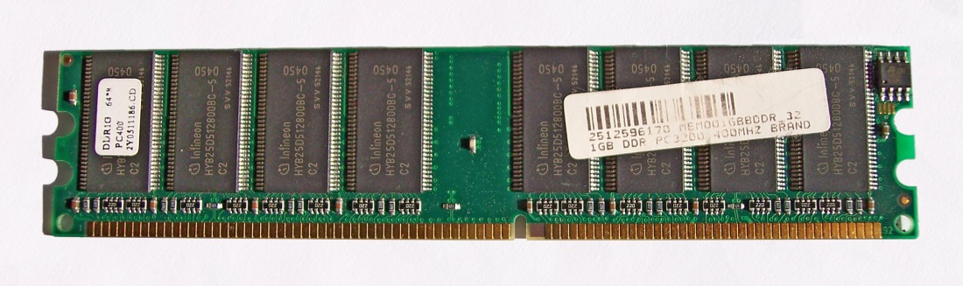
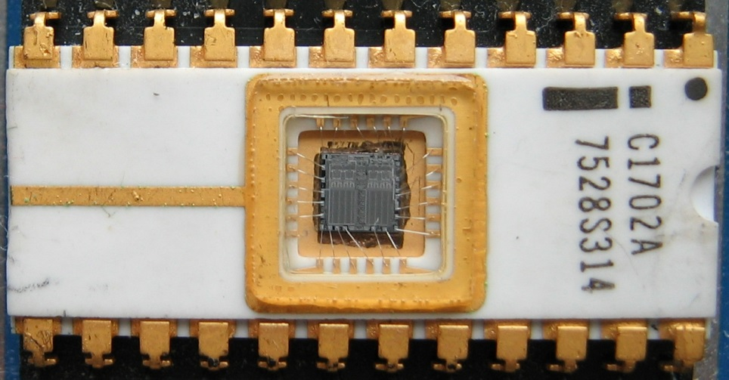
Two main types of memory
1. RAM (Random Access Memory) holds the program instructions and the data that is being used by the processor.
2. ROM (Read Only Memory) holds the program instructions and settings required to start up the computer.

Slide 7
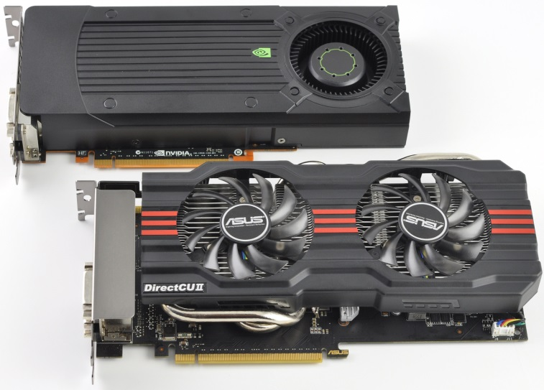
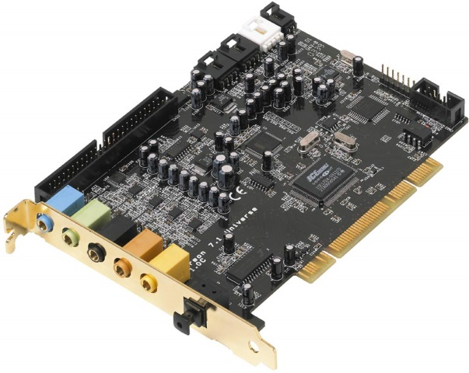
Expansion cards
Expansion cards contain the electronics required to communicate with and control the device e.g. video or graphic cards are used for monitors, soundcards are used for audio input/output and NICs (network interface cards) are used for connecting to other computers in a network

Slide 8
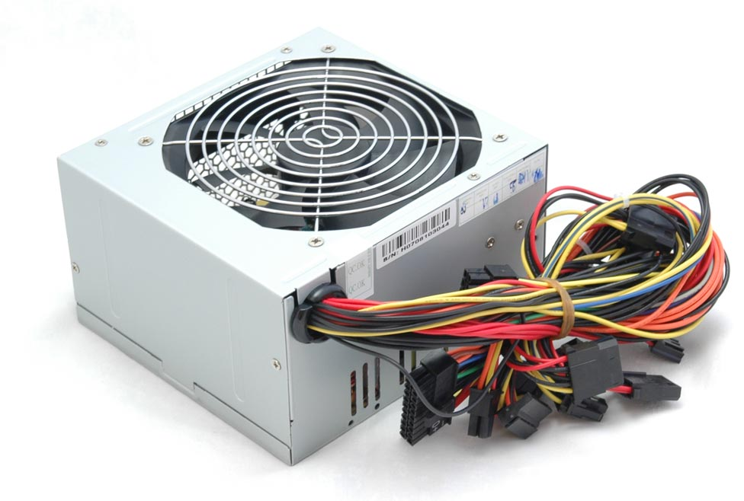
Power supply
A power supply unit converts mains AC to low-voltage regulated DC power for the internal components of a computer. Modern personal computers universally use a switched-mode power supply. Some power supplies have a manual selector for input voltage, while others automatically adapt to the supply voltage.

Slide 9
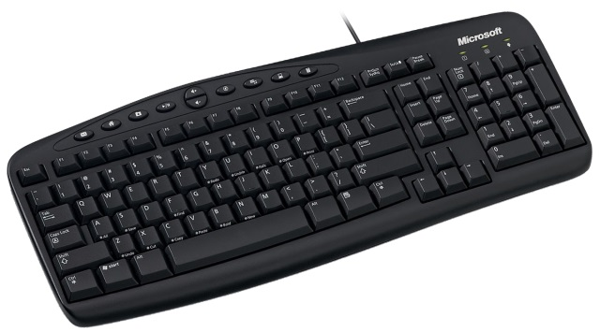
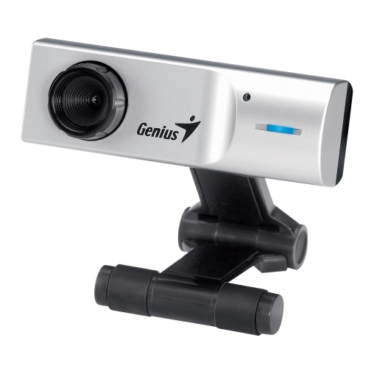
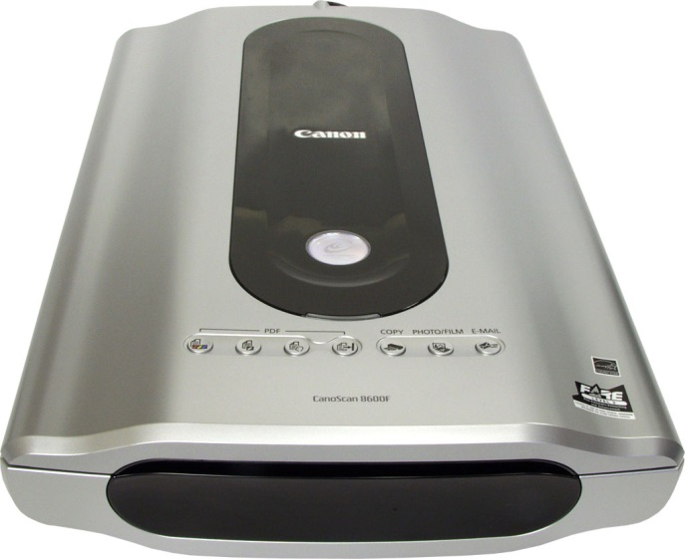
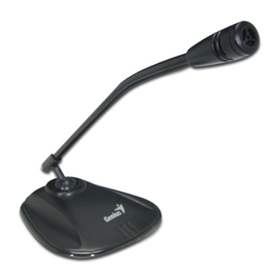
Input devices
1. Keyboard
2. Scanner
3. Barcode
4. Microphone
5.Webcam

Slide 10
Output devices
1. Monitor comprises the display device, circuitry and an enclosure. The display device in modern monitors is typically a thin film transistor liquid crystal display (TFT-LCD) thin panel, while older monitors used a cathode ray tube (CRT) about as deep as the screen size.
2. Printer is a peripheral which makes a representation of an electronic document on physical media. Individual printers are designed to support local and network users at the same time. Some printers can print documents stored on memory cards or from digital cameras and scanners.

Slide 11
3. Plotter is a computer printer for printing vector graphics. A plotter gives a hard copy of the output. It draws pictures on paper using a pen. Plotters are used to print designs of ships and machines, plans for buildings and so on.
4. Headphones are a pair of small loudspeakers that are designed to be held in place close to a user's ears. Headphones either have wires for connection to a signal source such as an audio amplifier, radio, CD player, portable media player, mobile phone, electronic musical instrument, or have a wireless receiver, which is used to pick up signal without using a cable.

Slide 12
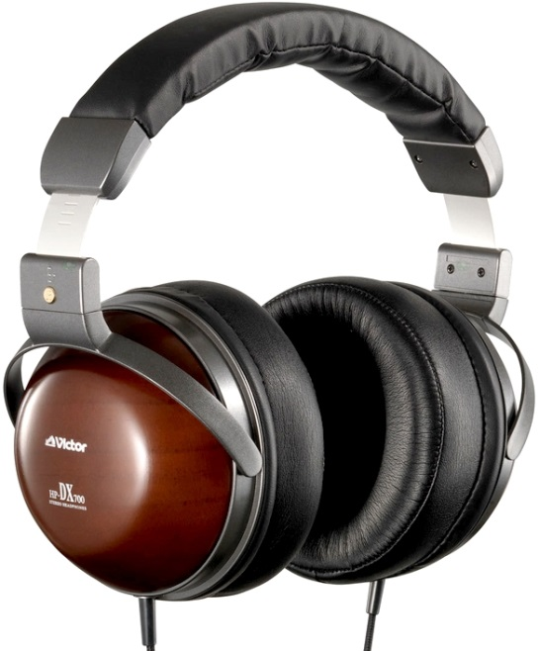
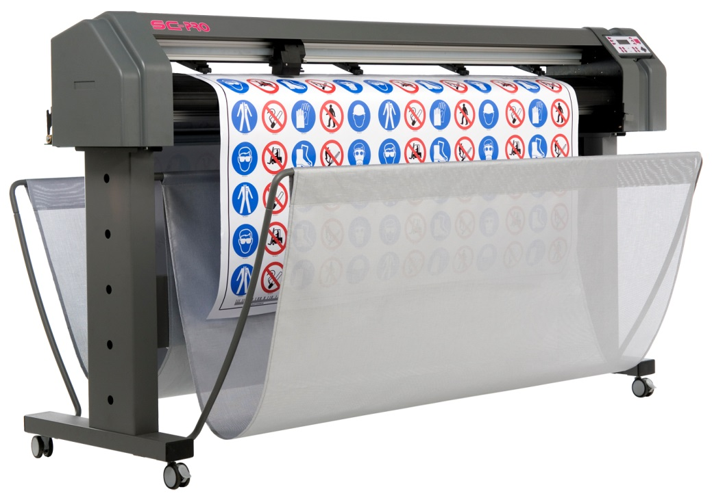
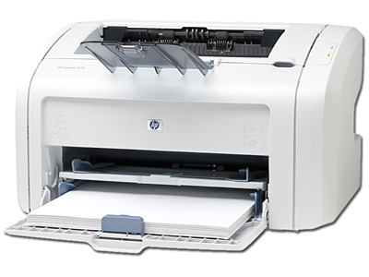
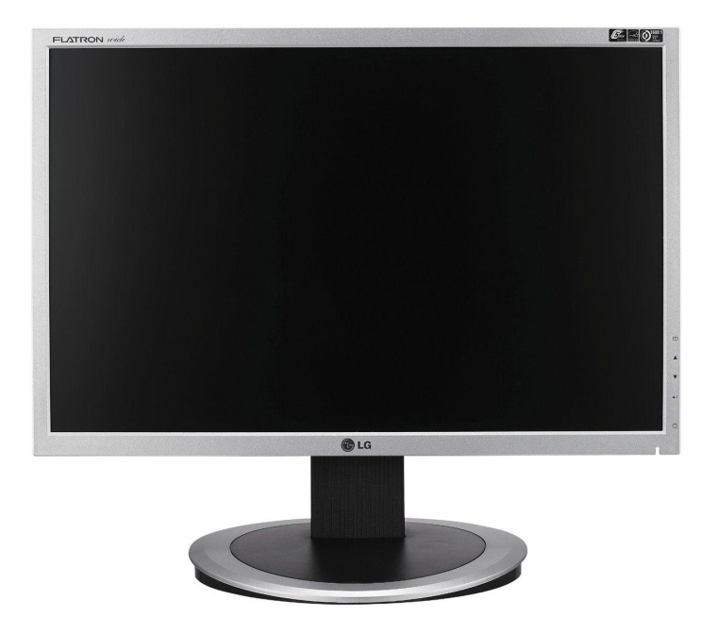

Slide 13
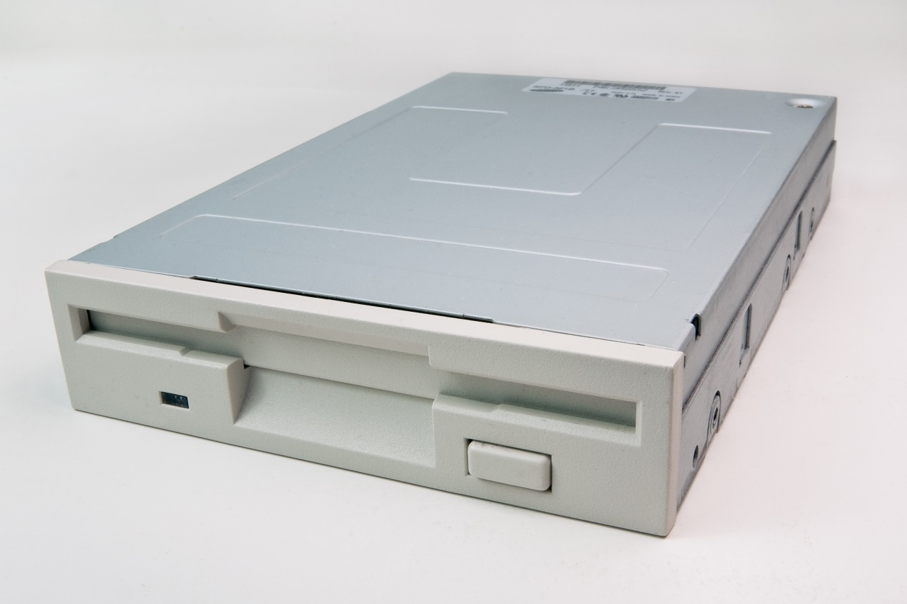
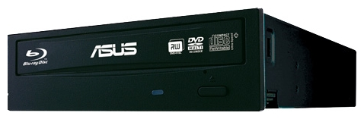
Storage devices
1. Magnetic tape
2. Floppy disc
3. Hard disk
4. CD, DVD and BLU-RAY discs

Slide 14
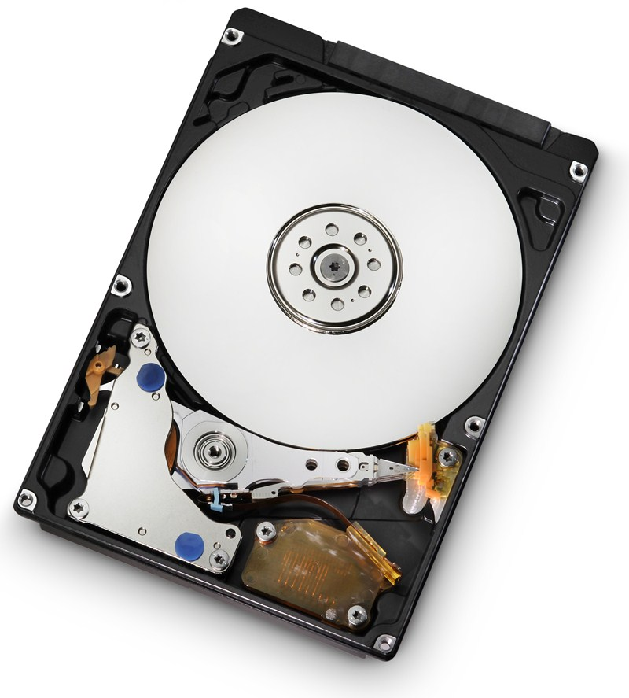
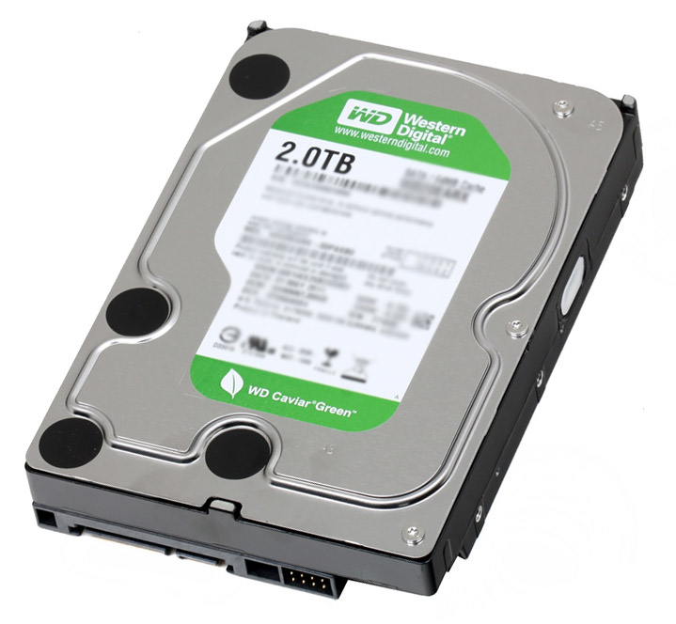
Storage devices in the form of a disk or tape are used to store the programs and data that are not being used. Before a program or data can be used, it must be transferred from the storage device to the main RAM memory

Slide 15
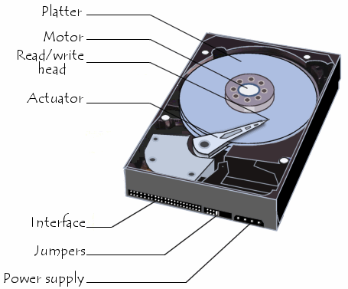
Structure of the hard disk
Hard disks consist of a set of magnetic coated metal disks that are vacuum-sealed inside a case to keep out the dust. The magnetic surfaces of the disks are formatted using a read/write head to provide magnetic storage areas. These storage areas form concentric circles called tracks and each track is subdivided into sections called sectors.

Slide 16
System bus
A set of connectors used for carrying signals between the different parts of a computer is known as a bus. Data is transferred constantly between the processor and memory along the system bus. Each part of memory has its own memory address and the processor determines where processed data is stored by sending an address signal along an address bus and data along a data bus

Slide 17
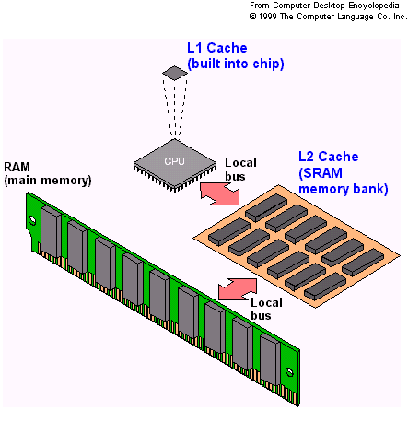
Cache
Transferring data between the processor and RAM can slow up the computer; therefore, some very expensive, extremely fast memory is usually used as a cache to hold the most frequently used data.

Slide 18
Speed and capacity
When comparing computers, the power of the computer is important. This is mainly determined by the speed and capacity (size) of each part of the computer.
Speed is measured in hertz (Hz) i.e. cycles per second.
Capacity is measured in bytes where 1 byte=8 bits (binary digits)

Slide 19
THE END
Thanks for watching

